Slide 1

WEEK 6 — Marketing & Branding
HopeBuilds: Dynamic Business Development Program
Facilitator: TBD
Content developed by Gregory Robinson III

Slide 2
Introduction & Objectives
Overview of Marketing, Advertising, and Press Releases
Understanding how to market your business through social media platforms
The benefits of advertising, press releases, and marketing your company
Learn how marketing and branding are beneficial for your company
See the effect social media and the internet have on your company
Learn how to utilize different design sources to easily market your company
HopeBuilds: Dynamic Business Development Program (DBDP)
Week 6

Slide 3
What Is Marketing?
“Marketing is the activity, set of institutions, and processes for creating, communicating, delivering, and exchanging offerings that have value for customers, clients, partners, and society at large.”
(American Marketing Association)
When you think of marketing, what comes to mind?
HopeBuilds: Dynamic Business Development Program (DBDP)
Week 6

Slide 4
Examples of Marketing
1
2
3
Content Marketing
Brand Management
Advertising
4
5
6
Public Relations
Search Engine Marketing (SEM)
Social Media Marketing
HopeBuilds: Dynamic Business Development Program (DBDP)
Week 6

Slide 5
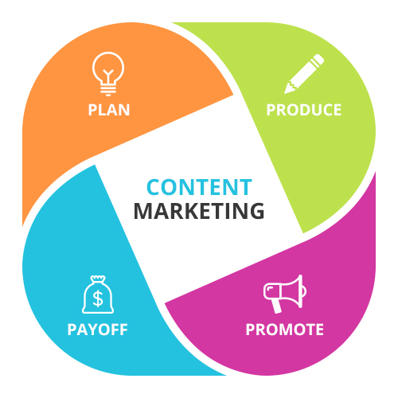
Content Marketing
Definition: anything that delivers information to an audience.
Goal: create valuable and useful content that promotes a company over time. Example: a podcast you listen to in the car, or your favorite morning newsletter.
Plan — know the goals or message you want to get across to consumers.
Produce — how will you make this content, how long will it take, when will you launch it?
Payoff — how much will it cost to make, and how much will you earn from it?
HopeBuilds: Dynamic Business Development Program (DBDP)
Week 6

Slide 6
Content Marketing — Notable Examples
Kim Kardashian
Keith Lee
Mr. Beast
AMP — Kai Cenat
HopeBuilds: Dynamic Business Development Program (DBDP)
Week 6

Slide 7
Brand & Brand Management
A brand is a type of product manufactured by a particular company under a particular name. Example: Gucci, Kellogg, Shein, Forever 21.
What are some of your favorite name brands?
Brand management is understanding why different groups of people act in different ways — while always staying focused on the big picture and creating a lasting tagline.
Example taglines: Nike, Nationwide, State Farm, Red Robin.
HopeBuilds: Dynamic Business Development Program (DBDP)
Week 6

Slide 8
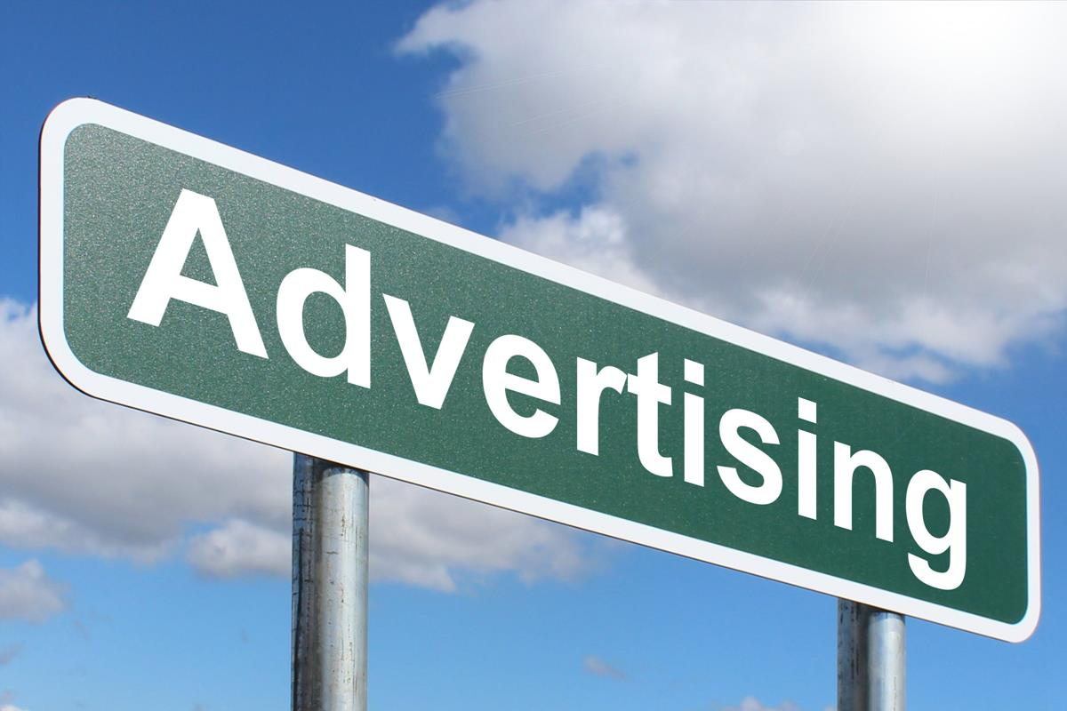
Advertising
Advertising is the process of persuasively communicating with consumers through paid mediums.
It's a way for you or your company to uniquely connect with consumers — finding the weird and making it funny or understandable.
Key questions: Who are you trying to reach? How can you best reach that audience? Are you open to feedback?
Examples: posters, social media ads, commercials, word of mouth.
HopeBuilds: Dynamic Business Development Program (DBDP)
Week 6

Slide 9
Public Relations
Definition: the professional maintenance of a favorable public image by a company, organization, or individual — managing how others see and feel about a person, brand, or company.
For corporations, PR focuses on maintaining a positive image while handling media requests and shareholder inquiries — especially important to defray outcry following negative news.
Bad press isn't always the worst outcome — it's a way for companies to spin a story toward a positive outcome. Examples: Tylenol, Kobe Bryant, COVID.
HopeBuilds: Dynamic Business Development Program (DBDP)
Week 6

Slide 10
Public Relations — Press Release
A press release is a written document sent to journalists or media outlets to announce something newsworthy — an upcoming event, company accomplishment, or community benefit.
A catchy headline summarizing the main point
A dateline (date and location)
An introduction answering the 5 Ws: who, what, when, where, why
A body with supporting details and facts
A boilerplate with background on the organization
A contact section with name, phone, and email
HopeBuilds: Dynamic Business Development Program (DBDP)
Week 6

Slide 11
What to Look For When Hiring for PR
A passionate voice, and the ability to express it in writing
A love of researching and collecting interesting information
The ability to put yourself in someone else's shoes to understand their desires and frustrations
HopeBuilds: Dynamic Business Development Program (DBDP)
Week 6

Slide 12
Social Media Marketing
Aims to leverage social media's massive reach to develop relationships with consumers, promote brand awareness, and drive traffic to a website or store.
Brands can reach consumers across the world, at all times of day, instantly.
Encompasses everything from responding to customer comments, to developing hashtag campaigns, to planning and composing posts.
What are your favorite social platforms, and how do you use them?
HopeBuilds: Dynamic Business Development Program (DBDP)
Week 6

Slide 13
Social Media Calendars
A regular calendar you set up for posting on your social media sites.
Example — planning for a Nov. 11 event: post at least twice one month in advance, then daily for the two weeks leading up to the event.
Posts don't all have to be the same format — mix in story shares, creative reminders, or content-creator collaborations.
HopeBuilds: Dynamic Business Development Program (DBDP)
Week 6

Slide 14
Facebook for Business
Have a personal Facebook account to confirm your identity, then go to business.facebook.com/overview and click Create Account.
Enter your business name, your name, work email, and business details, then create a Facebook Page with all necessary information.
Facebook offers many ways to market your business — creating events, sharing and commenting with peers, and exchanging business information with new connections.
To create an event: open the Events tab, click Create Event, enter the name/date/time/location, choose in-person or virtual, add a description, and click Create.
HopeBuilds: Dynamic Business Development Program (DBDP)
Week 6

Slide 15
Instagram for Business
Instagram is a photo and video sharing platform (owned by Meta) — media can be edited with filters, organized by hashtags, and geotagged. Posts can be public or shared with approved followers only.
Creating a business profile: connect your existing social accounts, use your business name (or something closely tied to it), and make sure your logo is ready before you set up your profile picture.
Add your business info and link to your website or booking site.
HopeBuilds: Dynamic Business Development Program (DBDP)
Week 6

Slide 16
Instagram — Content Types
Reels
  Videos that can be shared as posts on your regular Instagram page.
Story
  Videos or pictures you post or share for only 24 hours.
Posts
  General pictures or videos that stay on your page until you choose to delete them.
HopeBuilds: Dynamic Business Development Program (DBDP)
Week 6

Slide 17
TikTok
A short-form video hosting service (owned by ByteDance) — videos range from 15 seconds to 10 minutes, covering entertainment, comedy, dance, and lip-synching.
TikTok is the international version of Douyin (the Chinese-market app). Its mission: inspire creativity and bring joy.
Common content types: content creation, singing, product reviews, artwork.
HopeBuilds: Dynamic Business Development Program (DBDP)
Week 6

Slide 18
Social Media Analytics
The process of gathering and analyzing data from social networks — used by marketers to track conversations about products/companies, understand performance, and improve campaigns.
“The art and science of extracting valuable hidden insights from vast amounts of semi-structured and unstructured social media data to enable informed decision-making.”
On Facebook: access Insights under the Home category for an overview of Followers, Likes, Reach, Page Views, and more — available on web or mobile app.
Use analytics to monitor your own posts and study what your competitors are doing.
HopeBuilds: Dynamic Business Development Program (DBDP)
Week 6

Slide 19
Canva
A free, browser-based design tool for creating social media graphics, logos, flyers, and marketing materials — no design experience required.
Useful for building a consistent visual brand across your website, social posts, and printed materials.
HopeBuilds: Dynamic Business Development Program (DBDP)
Week 6

Slide 20
AI Tools for Marketing & Content Creation
AI tools can help small businesses create content faster — without needing a marketing team or design background.
ChatGPT: draft social media captions, email copy, product descriptions, and brainstorm content ideas.
Canva's AI features: Magic Design (auto-generate layouts), background remover, and AI image generation — built right into the tool you're already using.
Other tools worth exploring: AI-assisted social media scheduling and caption generators (e.g., within Buffer, Later, or similar platforms).
HopeBuilds: Dynamic Business Development Program (DBDP)
Week 6

Slide 21
Using AI Well — Not Instead of You
Treat AI output as a first draft, not a final product — always review and edit before posting.
Add your own voice, story, and specific details. AI-generated content can sound generic if you don't personalize it.
Fact-check anything AI tells you about your industry, competitors, or claims you plan to make publicly.
Your customers connect with your authentic story — AI can help you say it faster, but it shouldn't replace what makes your brand yours.
HopeBuilds: Dynamic Business Development Program (DBDP)
Week 6

Slide 22
Market Research
Definition: the systematic collection, analysis, and interpretation of data about a specific market, industry, or consumer segment — studying customers, competitors, and market dynamics to identify opportunities, mitigate risks, and make informed decisions.
Why it's important: know your competitors, better understand your business, compare product advantages, and identify funding opportunities.
HopeBuilds: Dynamic Business Development Program (DBDP)
Week 6

Slide 23
The Four Ps of Marketing
Product
  Goods or service
Price
  How much the customer pays
Place
  Where the product is marketed
Promotion
  Advertising and PR
HopeBuilds: Dynamic Business Development Program (DBDP)
Week 6

Slide 24
Market Research: The 9-Step Process
1. Identify the issue, discuss alternatives, and set objectives
2. Develop a research program
3. Choose a sample
4. Gather information
5. Gather data
6. Organize and analyze information
7. Present findings
8. Make research-based decisions
9. Take action based on insights
HopeBuilds: Dynamic Business Development Program (DBDP)
Week 6

Slide 25
Steps 1–3: Define & Design
Step 1 — Define the problem
  Understand the cause and develop a solution. Example: “Sales are not growing” (problem) → “Why are sales not growing?” (research). Focus on the why and how.
Step 2 — Develop a research method
  Follow the scientific method: define the problem, develop an explanation, make a prediction, devise and conduct a test, analyze results.
Step 3 — Choose a research method
  Experimental research, or non-experimental research.
HopeBuilds: Dynamic Business Development Program (DBDP)
Week 6

Slide 26
Steps 4–6: Collect
Step 4 — Develop a research design
  A plan/framework for conducting research and collecting data. Three core types: exploratory, descriptive, and causal.
Step 5 — Choose the sample
  Never examine the whole population — use a smaller, accurate representation instead.
Step 6 — Gather data
  O-Data and X-Data. Techniques: email, SMS, Slack, WhatsApp, social media. Record all results.
HopeBuilds: Dynamic Business Development Program (DBDP)
Week 6

Slide 27
Steps 7–9: Analyze & Act
Step 7 — Analysis and interpretation
Step 8 — Review the results
  Include your research process, results, conclusions, and recommended courses of action.
Step 9 — Turn information into action
  Act on important concerns, address product issues, improve marketing effectiveness, and grow your brand.
HopeBuilds: Dynamic Business Development Program (DBDP)
Week 6

Slide 28
Target Audience
A group of people identified as likely customers of a business, sharing similar demographic traits: age, gender, location, education, socioeconomic status.
Start by thinking about the specific needs your product or service fulfills — the more specific your audience, the more effective your advertising.
A general product needs less market research to find its audience; a specific audience requires gathering more data to narrow your focus.
One way to collect data: offer a special price or coupon code in exchange for a survey.
HopeBuilds: Dynamic Business Development Program (DBDP)
Week 6

Slide 29
S.W.O.T. Analysis
Strengths
  How is this beneficial to the company, and what will it do for consumers?
Weaknesses
  What could stop this product from offering the best service?
Opportunities
  What new doors can this open for you?
Threats
  Who is your competition, and what are they offering that you're not?
HopeBuilds: Dynamic Business Development Program (DBDP)
Week 6

Slide 30
S.W.O.T. Analysis
HELPFUL
HARMFUL
INTERNAL
Strengths
Weaknesses
Internal advantages: strong brand, innovative culture, experienced team
Internal obstacles: limited resources, high costs, outdated technology
EXTERNAL
Opportunities
Threats
External conditions to leverage: emerging markets, rising demand
External risks: increased competition, economic downturns
HopeBuilds: Dynamic Business Development Program (DBDP)
Week 6

Slide 31
When to Use a SWOT Analysis
Before implementing a large change, as part of a change management plan
When launching a new company initiative
To identify opportunities for growth and improvement
Any time you want a full overview of business performance
SWOT analyses are general by design — they apply to almost any scenario, project, or business, and can even be used for a personal SWOT of your own skills.
HopeBuilds: Dynamic Business Development Program (DBDP)
Week 6

Slide 32
Logos: Making a Name for Yourself
A logo is a symbol or design that identifies a company, organization, or its products, services, and employees — it's how your company is recognized and remembered, and functions as the face of your business.
Your logo can make a statement about your organization. Example: Amazon's smiley arrow communicates “A to Z” and customer happiness.
Think outside the box, know what your company represents, and keep it cohesive with your brand.
HopeBuilds: Dynamic Business Development Program (DBDP)
Week 6

Slide 33
Assessment & Evaluation
Quiz: What are some of the social media sites you can use to benefit your company?
Feedback on training: Did you find these strategies helpful? Do you feel like you have a better grasp on the subject?
HopeBuilds: Dynamic Business Development Program (DBDP)
Week 6

Slide 34
Disclaimer
This presentation is provided for educational purposes as part of the HopeBuilds: Dynamic Business Development Program (DBDP) and does not constitute legal, financial, tax, or other professional advice. Participants should consult a qualified professional before making business, legal, or financial decisions.
Completion of this program does not guarantee funding, loan approval, business success, or any specific outcome.
Participation in DBDP is voluntary, and Word of Hope Ministries, Inc. is not liable for loss, injury, or damages arising from a participant's involvement in the program.
Full program policies, including data use, photo/media release, and liability terms, are available from WOHM upon request.
HopeBuilds: Dynamic Business Development Program (DBDP)
Week 6

Slide 35
Thank You
HopeBuilds: Dynamic Business Development Program (DBDP)
Word of Hope Ministries, Inc. | 2677 N. 40th Street, Milwaukee, WI 53210 | 414-447-1965

