Slide 1

WEEK 5 — What Is Your Organizational Culture?
HopeBuilds: Dynamic Business Development Program
Facilitator: Loretta A. Howard, PhD
Howard Communication Strategy Consultants

Slide 2
Definition
Organizational Culture is the unique, dominant pattern of shared beliefs, assumptions, values, and norms that shape the socialization, symbols, language, and practices of a group of people.
The attitudes and approaches that typify the way staff carry out their tasks.
Organizational Culture is developed and transmitted by people, consciously and unconsciously, to subsequent generations of employees.
HopeBuilds: Dynamic Business Development Program (DBDP)
Week 5

Slide 3
The Organizational Culture Iceberg
Observable Elements
Not Observable
Practices
Language
Symbols
Norms
Values
Assumptions
HopeBuilds: Dynamic Business Development Program (DBDP)
Week 5

Slide 4
ACTIVITY
Culture Crush Activity
In teams, answer the following question: “On what organizations do we have a culture crush?”
Think about companies that people often talk about emulating.
List them in the hearts on the worksheet, then note the reasons why you have a crush on them.
Next, think about organizations that are the antithesis of the culture you want.
Fill in the drops on the worksheet and note why for each.
HopeBuilds: Dynamic Business Development Program (DBDP)
Week 5

Slide 5
Four Basic Types of Culture
1
2
3
4
Bureaucratic
Clan
Market
Adhocracy
HopeBuilds: Dynamic Business Development Program (DBDP)
Week 5

Slide 6
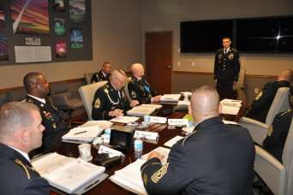
Bureaucratic Culture
The behavior of employees is governed by formal rules and standard operating procedures.
Such a culture perpetuates stability.
Organizations with bureaucratic culture tend to produce standardized goods and services.
Examples: Government entities, fast food establishments.
HopeBuilds: Dynamic Business Development Program (DBDP)
Week 5

Slide 7

Clan Culture
The behavior of individuals is shaped by tradition, loyalty, personal commitment, extensive socialization, and self-management.
A clan culture achieves unity through socialization.
Long-term employees serve as mentors.
Members are aware of the organization's history and understand the expected manner of conduct and organizational style.
Members share feelings of pride in membership; peer pressure to adhere to important norms is strong.
HopeBuilds: Dynamic Business Development Program (DBDP)
Week 5

Slide 8
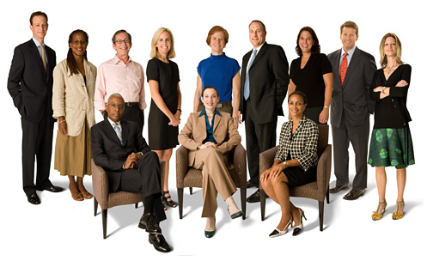
Market Culture
Values and norms reflect the significance of achieving measurable and demanding goals, mainly financial and market-based.
Companies with a market culture tend to focus on sales growth, profitability, and market share.
The relationship between individuals and the organization is contractual.
Managers are judged not on their effectiveness as mentors, but on performance goals based on profit.
HopeBuilds: Dynamic Business Development Program (DBDP)
Week 5

Slide 9

Adhocracy Culture
Characterized by high levels of risk-taking and creativity.
There is a commitment to experimentation, innovation, and being creative.
Adhocracy cultures value individuality — employees are encouraged to think creatively and bring their ideas to the table.
HopeBuilds: Dynamic Business Development Program (DBDP)
Week 5

Slide 10
Understanding the Culture of Your Organization
Different people in the same organization can have different perceptions of its culture.
This is especially true regarding perceptions between the top and bottom levels of the organization.
For example, the Chief Executive may view the organization as highly focused, well organized, and even rather formal.
On the other hand, the receptionist might view the organization as confused, disorganized, and sometimes even rude.
HopeBuilds: Dynamic Business Development Program (DBDP)
Week 5

Slide 11
Basic Guidelines to Assess Your Organization's Culture
Understand some of the major types of culture. There are several research efforts that have produced lists of different types of culture — you have been provided a list to review some of these.
HopeBuilds: Dynamic Business Development Program (DBDP)
Week 5

Slide 12
Basic Guidelines to Assess Your Organization's Culture (cont.)
Describe the culture of your organization. Consider what you see and hear, not what you feel and think. Answer the following:
Who seems to be accepted, and who doesn't? What is it about those who are accepted compared to those who are not?
What kinds of behaviors get rewarded? For example: getting along, getting things done, other behaviors?
What does management pay the most attention to? For example: problems, successes, crises, other behaviors?
How are decisions made? For example: by one person, discussion and consensus, or are decisions made at all?
HopeBuilds: Dynamic Business Development Program (DBDP)
Week 5

Slide 13
Basic Guidelines to Assess Your Organization's Culture (cont.)
Note there may not be close alignment between what the organization says it values (e.g., creativity, innovation, team-building) compared to what you're seeing (e.g., conformity, individualism).
This disparity is rather common in organizations. You might explain this disparity to other leaders in the organization.
An ideal time to address this disparity is when developing a values statement during the strategic planning process.
HopeBuilds: Dynamic Business Development Program (DBDP)
Week 5

Slide 14
Changing the Culture of an Organization
There are four primary ways to influence the culture of an organization.
1. Emphasize what's important — this includes widely communicating the organization's goals, posting the mission statement, talking about accomplishments, and repeating what you want to see in the workplace.
2. Reward employees whose behaviors reflect what's important.
HopeBuilds: Dynamic Business Development Program (DBDP)
Week 5

Slide 15
Changing the Culture of an Organization (cont.)
3. Discourage behaviors that don't reflect what's important. There is no need to punish or cause prolonged discomfort — instead, dissuade the employee from continuing unwanted behaviors through constructive feedback, verbal warnings, written warnings, or termination.
4. Model the behaviors that you want to see in the workplace. This is perhaps the most powerful way to influence behavior. For example, if you want more teamwork, involve yourself in teams more often.
HopeBuilds: Dynamic Business Development Program (DBDP)
Week 5

Slide 16
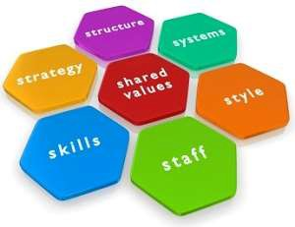
An Organization's Success Depends on Its Culture
Teamwork, motivation, inspiration, leadership, vision, and innovation all stem from a strong organizational culture.
Culture is not a soft, secondary concern — it is a foundational driver of business success.
HopeBuilds: Dynamic Business Development Program (DBDP)
Week 5

Slide 17
Disclaimer
This presentation is provided for educational purposes as part of the HopeBuilds: Dynamic Business Development Program (DBDP) and does not constitute legal, financial, tax, or other professional advice. Participants should consult a qualified professional before making business, legal, or financial decisions.
Completion of this program does not guarantee funding, loan approval, business success, or any specific outcome.
Participation in DBDP is voluntary, and Word of Hope Ministries, Inc. is not liable for loss, injury, or damages arising from a participant's involvement in the program.
Full program policies, including data use, photo/media release, and liability terms, are available from WOHM upon request.
HopeBuilds: Dynamic Business Development Program (DBDP)
Week 5

Slide 18
Thank You
HopeBuilds: Dynamic Business Development Program (DBDP)
Word of Hope Ministries, Inc. | 2677 N. 40th Street, Milwaukee, WI 53210 | 414-447-1965

